Slide 1


CAMPUS EVENT REGISTRATION
&
PARTICIPANT MANAGEMENT SYSTEM
Data Structures (with C) - Course Code: 102040304
GROUP 7
Submitted By:
Harshita Mohapatra (12502040701039)
Harshkumar Pande (12502040701040)
Submitted To:
Mrs. Maulika Patel

Slide 2
Introduction
The Campus Event Registration and Participant Management System is a console-based application developed in C for the Data Structures subject. It manages student registrations for various campus events.
The project uses the Singly Linked List data structure to store and manage participant details dynamically. It supports registration, displaying participant records, searching, updating details, cancelling registrations, and counting participants.
This project demonstrates the practical application of linked lists in managing and organizing participant information efficiently.
Input: Participant ID, name, event name, and event category.
Output: Participant details, search results, updated records, registration status, and total participant count.
Data Structure: Singly Linked List.

Slide 3
Motivation
The project is developed to understand the practical use of the singly linked list data structure in managing campus event registrations. It helps us understand how participant records can be stored, accessed, modified, and deleted dynamically.
The main motivation is:
To apply Data Structures concepts using C.
To understand linked list operations such as insertion, traversal, searching, and deletion.
To learn dynamic memory allocation using malloc() and free().
To develop an efficient system for managing participant registrations.
To improve programming and problem-solving skills.

Slide 4
Problem Statement and Objective
The aim of this project is to develop a Campus Event Registration and Participant Management System using a Singly Linked List in C. It manages participant registrations for various campus events and allows users to maintain participant records.
The linked list is used to store and manage participant details dynamically.
The program does the following:
Registers new participants for campus events.
Displays all registered participants.
Searches for participants using their registration ID.
Updates participant details.
Cancels existing registrations.
Counts the total number of participants.
Provides a simple menu-driven interface.
This project demonstrates the practical use of a singly linked list in managing and organizing participant information.

Slide 5
Tech Stack and Operations used
The project is developed in C for the Data Structures subject. A Singly Linked List is used to store and manage participant details dynamically.
Each node contains participant information and a pointer to the next node.
The main operations are:
Insertion: Adds a new participant to the list.
Traversal: Displays all registered participants.
Searching: Finds a participant using their registration ID.
Updating: Modifies the details of an existing participant.
Deletion: Removes a participant's registration from the list.
These operations help the program manage participant records efficiently and demonstrate the practical use of linked lists.

Slide 6
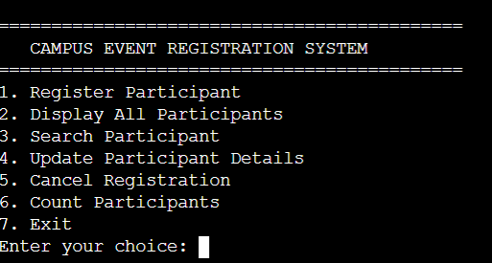
Implementation Screenshots
PART-1: PROGRAM START AND MENU
When the program starts, it displays the project title and menu options. The user selects an operation to manage participant registrations.
Displays the project title and menu.
Accepts the user's choice.
Loads sample participant records.
Performs the selected operation.

Slide 7
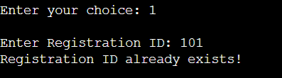
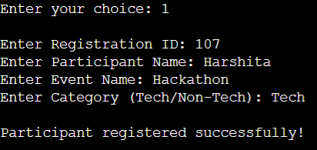



Implementation Screenshots
PART-2: REGISTER PARTICIPANT
This part adds new participants to the linked list.
Accepts participant details.
Checks for duplicate IDs.
Adds a new node to the list.

Slide 8
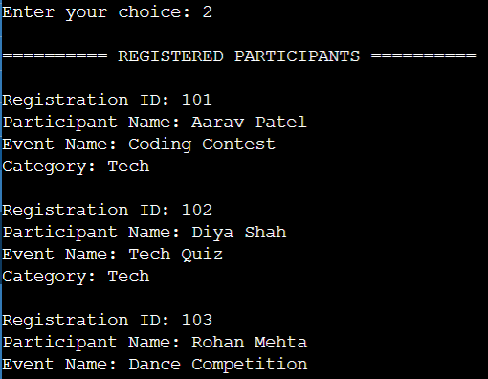
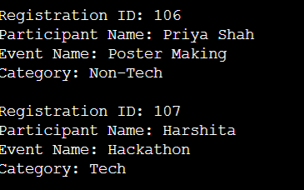
Implementation Screenshots
PART-3: DISPLAY PARTICIPANTS
This part displays all registered participants.
Traverses the linked list.
Displays participant details.
Shows a message if the list is empty.

Slide 9
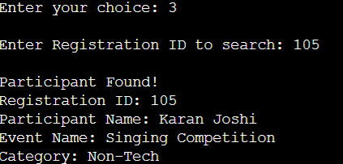
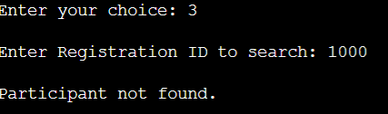
Implementation Screenshots
PART-4: SEARCH PARTICIPANT
This part searches for a participant using their registration ID.
Accepts the registration ID.
Compares IDs while traversing the list.
Displays the matching details or a not-found message.

Slide 10
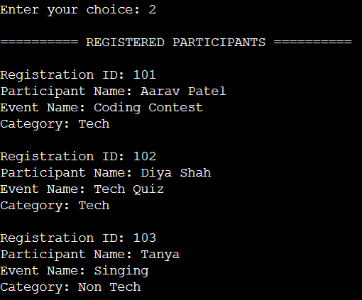
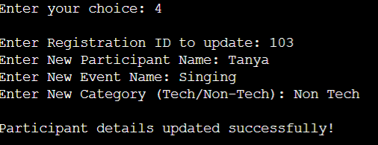
Implementation Screenshots
PART-5: UPDATE PARTICIPANT
This part modifies the details of an existing participant.
Searches by registration ID.
Updates the participant's details.
Displays the updated information.

Slide 11
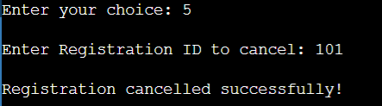
Implementation Screenshots
PART-6: CANCEL REGISTRATION
This part removes a participant from the linked list.
Searches for the participant's ID.
Deletes the corresponding node.
Frees the allocated memory.

Slide 12

Implementation Screenshots
PART-7: COUNT PARTICIPANTS
This part calculates the total number of registered participants.
Traverses the linked list.
Counts each node.
Displays the total count.

Slide 13
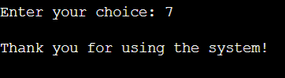
Implementation Screenshots
PART-8: EXIT PROGRAM
This part safely terminates the program.
Releases memory used by remaining nodes.
Displays the exit message.
Ends program execution.

Slide 14
Conclusion
The Campus Event Registration and Participant Management System was developed using the C programming language and the Singly Linked List data structure.
The project successfully performs various operations, including participant registration, displaying records, searching, updating details, cancelling registrations, and counting participants.
The use of linked lists allows participant records to be managed dynamically through insertion, traversal, and deletion operations.
The project helped us understand the practical application of Data Structures in solving real-world problems and improved our knowledge of pointers, dynamic memory allocation, and linked list operations in C.
Overall, this project strengthened our programming and problem-solving skills and demonstrated how data structures can be used to develop an efficient participant management system.

Slide 15
THANK YOU!

